Slide 1
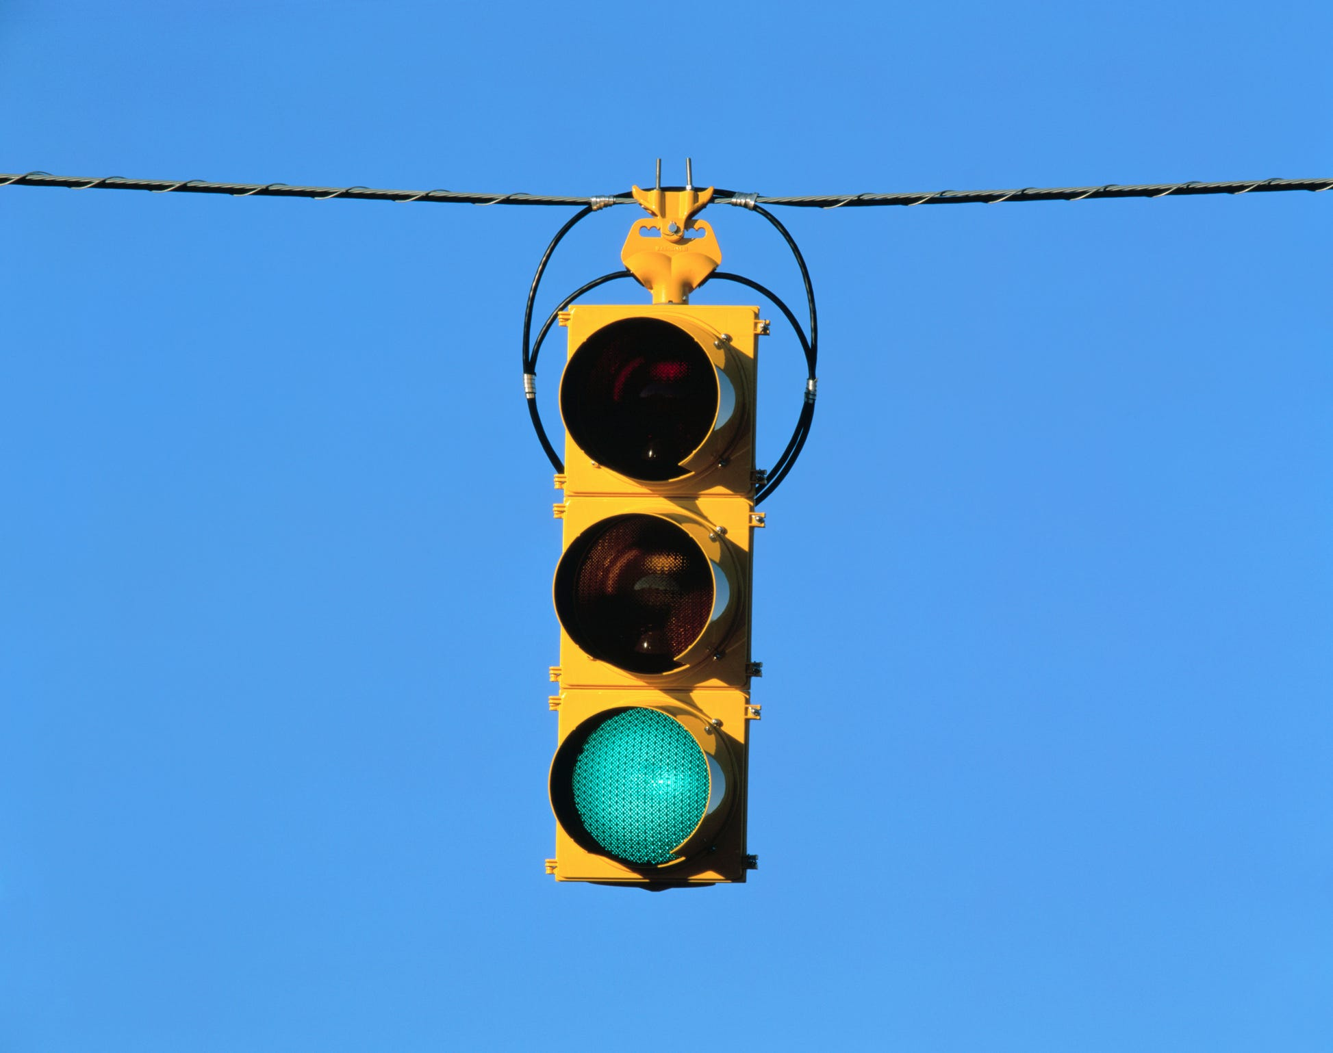
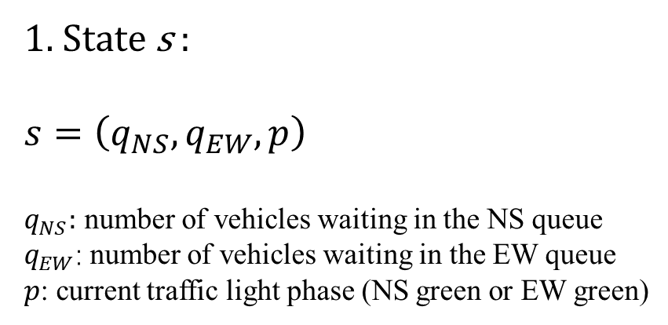
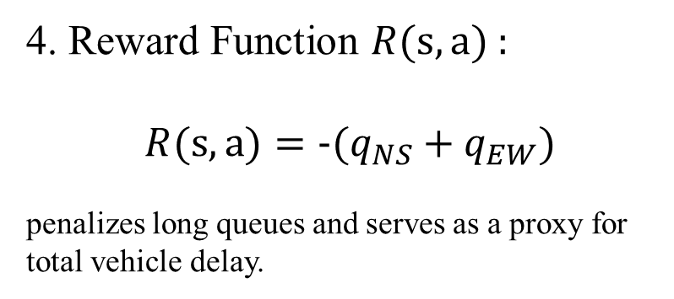
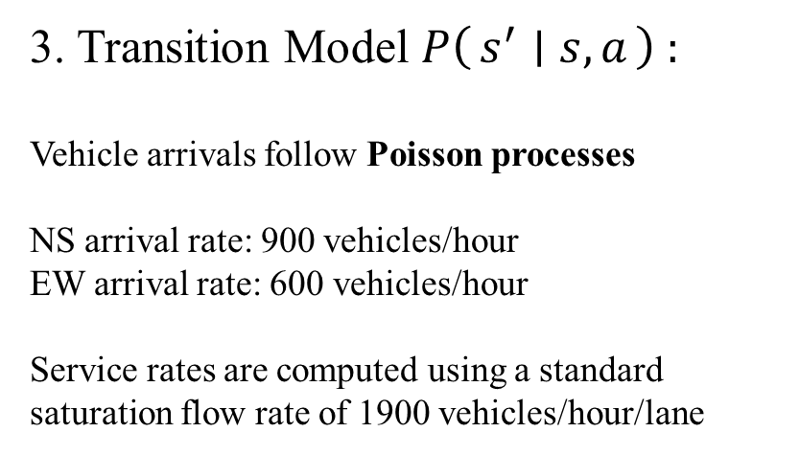
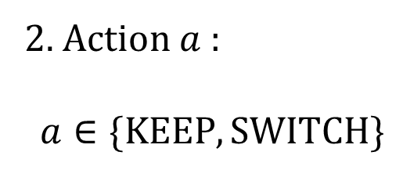
MDP Formulation
1. State s :
$$s=\left(q_{NS},q_{EW},p\right)$$
$q_{NS}:$ number of vehicles waiting in the NS queue
$q_{EW}$: number of vehicles waiting in the EW queue
$p$: current traffic light phase (NS green or EW green)
3. Transition Model $P\left(s^{′} ∣ s,a\right)$:
Vehicle arrivals follow Poisson processes
NS arrival rate: 900 vehicles/hour
EW arrival rate: 600 vehicles/hour
Service rates are computed using a standard saturation flow rate of 1900 vehicles/hour/lane
2. Action $a$ :
$$a∈\{KEEP, SWITCH\}$$
4. Reward Function $R(s, a)$:
$$R(s, a)=-(q_{NS}+q_{EW})$$
penalizes long queues and serves as a proxy for total vehicle delay.
5. Discount Factor γ :
γ = 0.98

Slide 2
Experimental results from your policy iteration
Methodology
Based on New York City – Traffic Volume Counts
Both policy evaluation and policy improvement
steps are implemented from scratch in Python
No reinforcement learning libraries were used
Time step: 5 seconds
Yellow/all-red lost time: 10 seconds
Baseline Policies
Fixed-time control (predefined green durations)
Queue-threshold control (switch when the opposing queue is larger)
Optimal MDP policy (policy iteration)
Performance Comparison:
=== Results (mean over episodes) ===
Fixed-time : avg_queue=34.389, delay=129.52s/veh, maxQ=40.00
Threshold : avg_queue=35.865, delay=136.73s/veh, maxQ=40.00
Optimal PI : avg_queue=20.676, delay=113.64s/veh, maxQ=27.20

